Slide 1
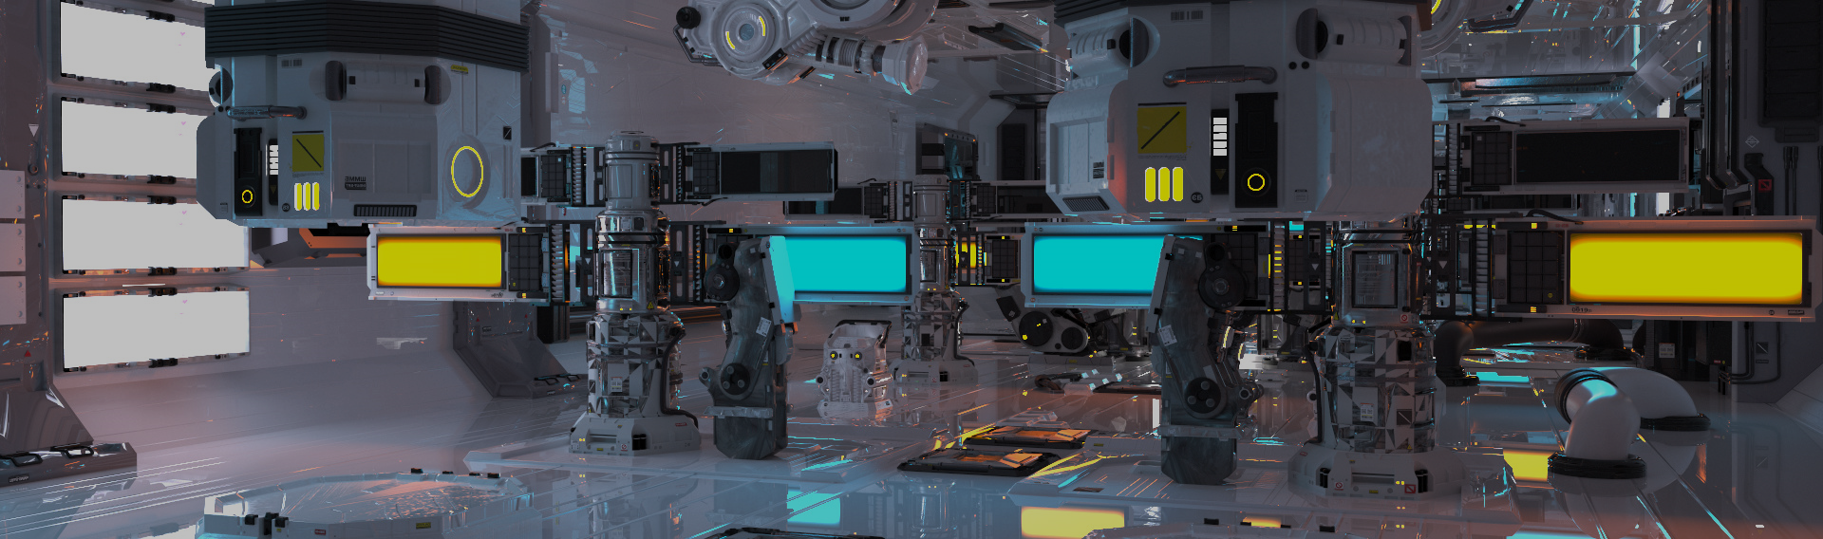
GPU Shader 1
電腦圖學導論實習
Information Technology Innovation | NTUST

Slide 2
Overview
The OpenGL Pipeline
The OpenGL Pipeline with Shaders
Program、VBO、VAO
Texture
Shader
P4 Water Surface

Slide 3
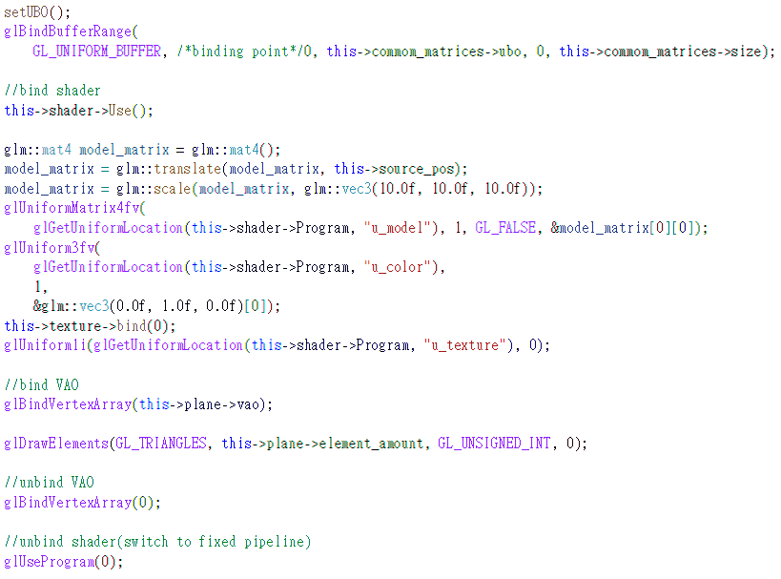
P4 Water Surface

Slide 4
The OpenGL Pipeline with Shaders
Vertices with:
Colors
Texture coords
Normals
Vertex Shader
Rasterize + Interpolate
Fragment Shader

Slide 5
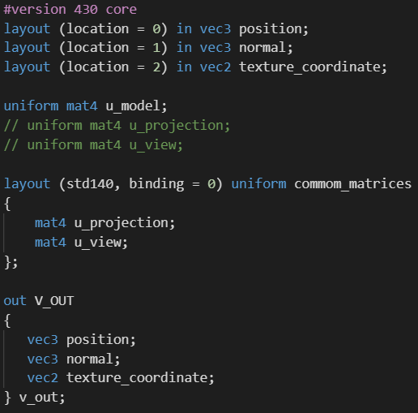
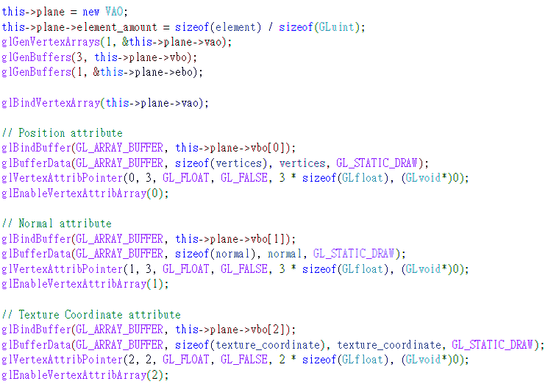
Simple.vert

Slide 6
The OpenGL Pipeline with Shaders
Vertex Shader
Transformed Vertices with:
(Anything you want here, eg normals, colors, texture coords)
Texture Memory
Rasterize + Interpolate
Fragment Shader

Slide 7
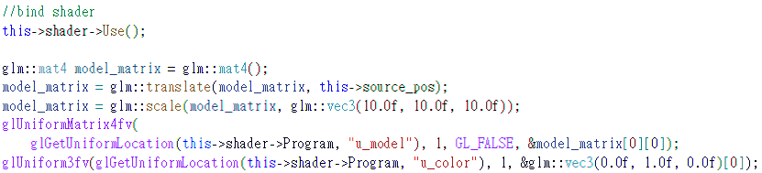
Simple.vert

Slide 8
Simple.vert

Slide 9
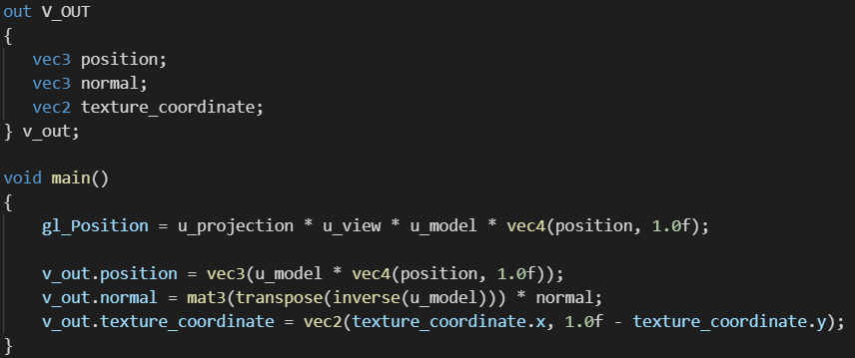
Simple.vert

Slide 10
The OpenGL Pipeline with Shaders
Vertex Shader
Rasterize + Interpolate
Fragments with:
(Interpolated values from previous stage)
Fragment Shader

Slide 11
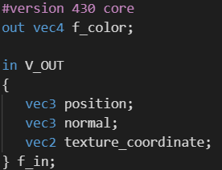
Simple.frag

Slide 12
The OpenGL Pipeline with Shaders
Vertex Shader
Texture Memory
Rasterize + Interpolate
Fragment Shader
Fragments with:
Colors

Slide 13
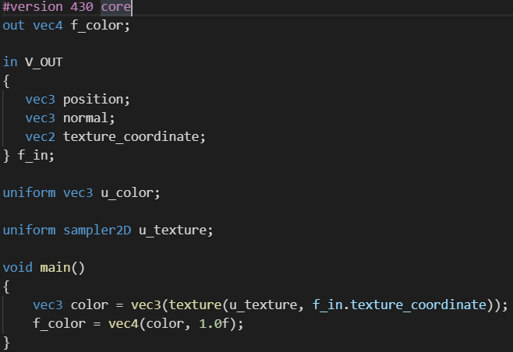
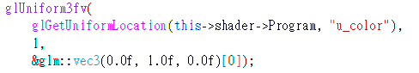
Simple.frag

Slide 14
Simple.frag

Slide 15
Simple.frag

Slide 16
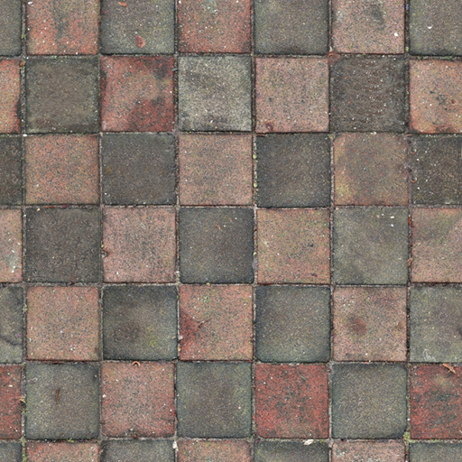
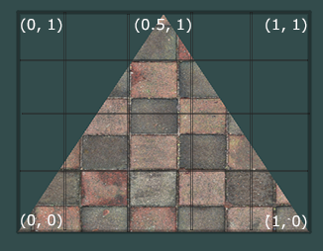
Texture
A texture is a 2D image used to add detail to an object.
Next to images color, textures can also be used to store a large collection of arbitrary data to send to the shaders.
(0,1)
(1,1)
(0,0)
(1,0)

Slide 17
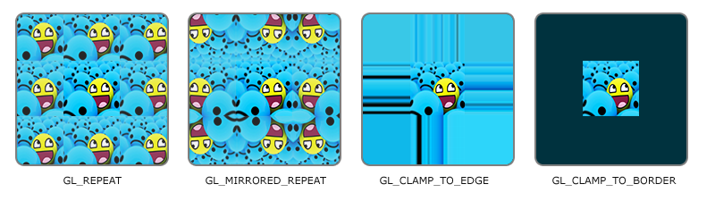
Texture Wrapping
Texture coordinates usually range from (0,0) to (1,1) but what happens if we specify coordinates outside this range?
glTexParameteri(GL_TEXTURE_2D, GL_TEXTURE_WRAP_S, GL_MIRRORED_REPEAT); glTexParameteri(GL_TEXTURE_2D, GL_TEXTURE_WRAP_T, GL_MIRRORED_REPEAT);

Slide 18

Texture Filtering
Texture coordinates do not depend on resolution but can be any floating point value, thus OpenGL has to figure out which texture pixel (also known as a texel ) to map the texture coordinate to.
glTexParameteri(GL_TEXTURE_2D, GL_TEXTURE_MIN_FILTER, GL_LINEAR); glTexParameteri(GL_TEXTURE_2D, GL_TEXTURE_MAG_FILTER, GL_LINEAR);

Slide 19
The OpenGL Pipeline
Modelview Transform
Lighting
Perspective Transform
Rasterization
Texturing

Slide 20
The OpenGL Pipeline with Shaders
Vertex Shader
Rasterize + Interpolate
Fragment Shader

Slide 21
The OpenGL Pipeline with Shaders
Vertex Shader
Small programs that run on the graphics card
Rasterize + Interpolate
Fragment Shader

Slide 22
The OpenGL Pipeline with Shaders
Vertices with:
Colors
Texture coords
Normals
Vertex Shader
Rasterize + Interpolate
Fragment Shader

Slide 23
The OpenGL Pipeline with Shaders
Vertex Shader
Transformed Vertices with:
(Anything you want here, eg normals, colors, texture coords)
Texture Memory
Rasterize + Interpolate
Fragment Shader

Slide 24
The OpenGL Pipeline with Shaders
Vertex Shader
Rasterize + Interpolate
Fragments with:
(Interpolated values from previous stage)
Fragment Shader

Slide 25
The OpenGL Pipeline with Shaders
Vertex Shader
Texture Memory
Rasterize + Interpolate
Fragment Shader
Fragments with:
Colors

Slide 26
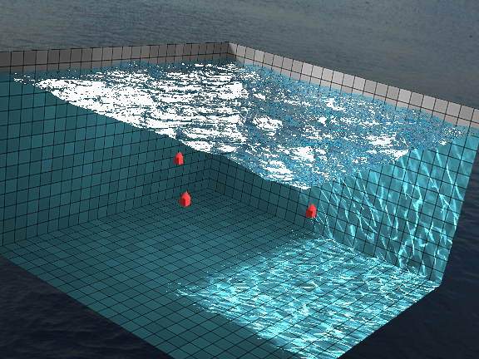
P3-2 Water Surface
http://madebyevan.com/webgl-water/
Shader.h
BufferObject.h
Texture.h
Shader
Simple.vert
Simple.frag

Slide 27
Homework
Reference
https://learnopengl.com/Getting-started/Hello-Triangle
https://learnopengl.com/Getting-started/Shaders
TODO
Draw a triangle with a RGB gradient (with vertices in R/G/B colors).
Apply a texture of a church onto a triangle, and make sure the image does not become distorted or warped.( /Images/church.png )
Combine the previous two tasks

Slide 28
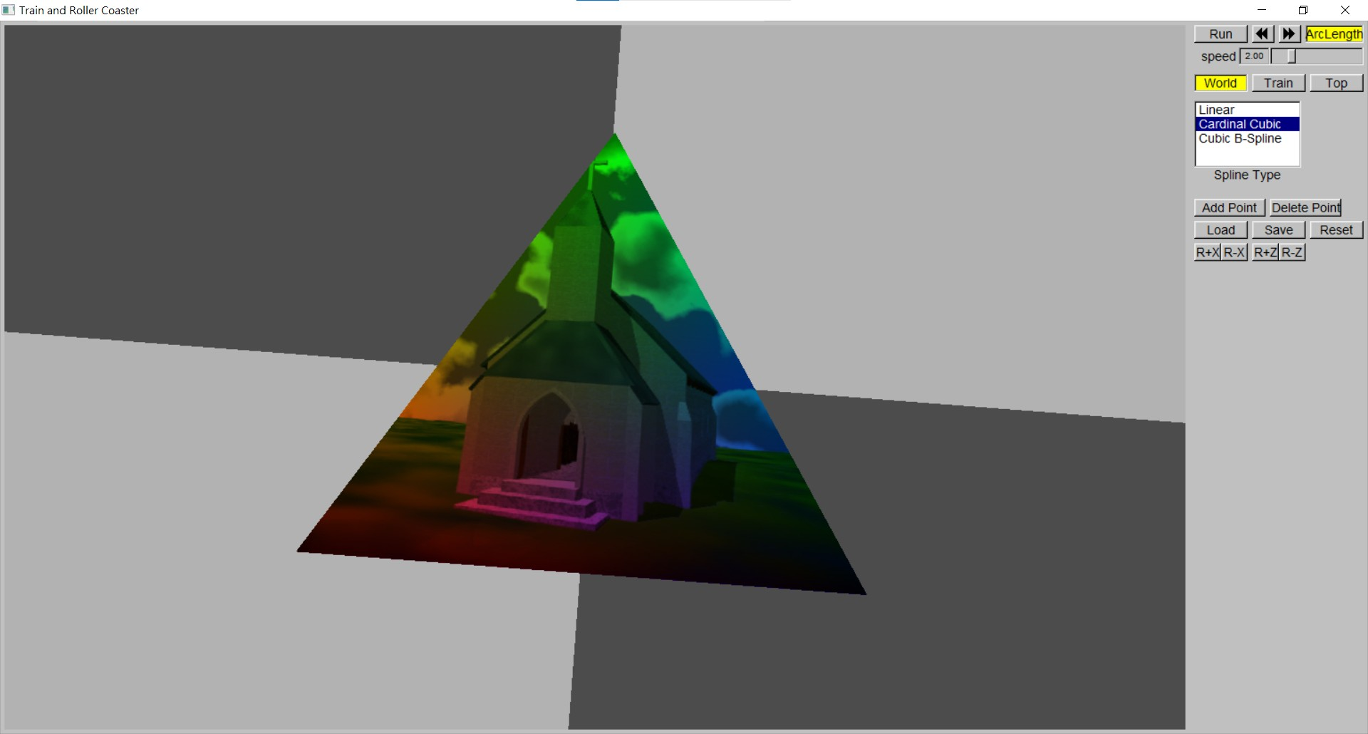
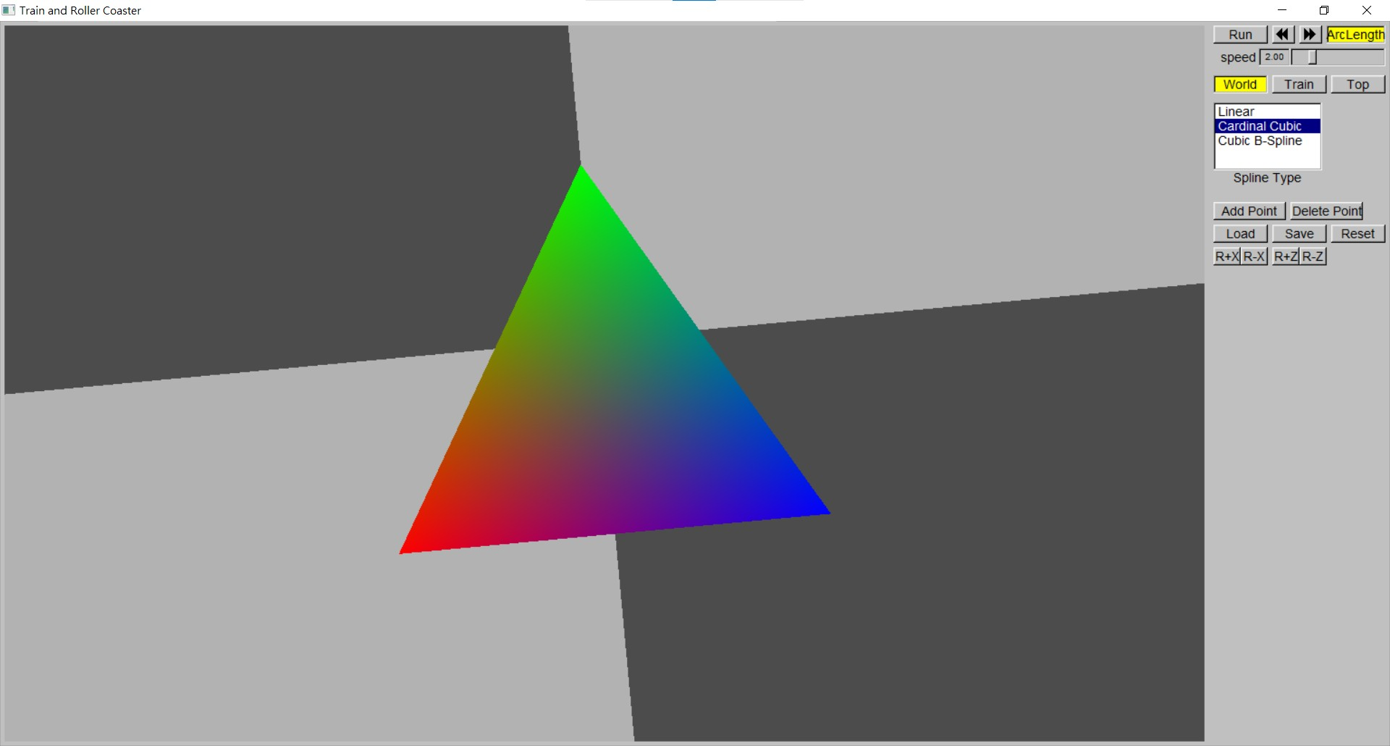
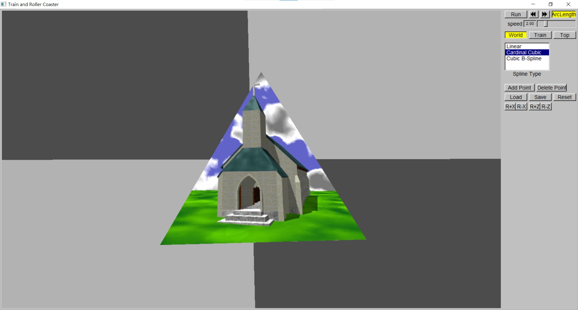
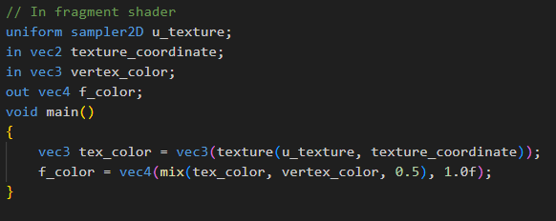
Hw09
Shader: Color and Texture
=
+

